Slide 1
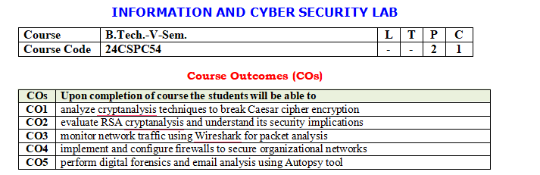

Slide 2
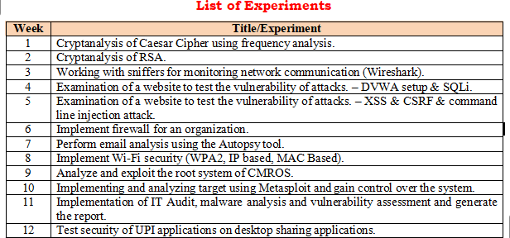

Slide 3
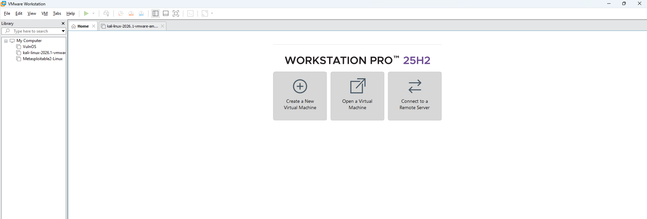
VMware
VMware Workstation is virtualization software. It allows you to run multiple operating systems on a single physical computer without replacing your main operating system.
For example:
Your computer runs Windows 11.
Using VMware, you can install and run Kali Linux inside a virtual machine.
Both Windows and Kali Linux can run at the same time.

Slide 4
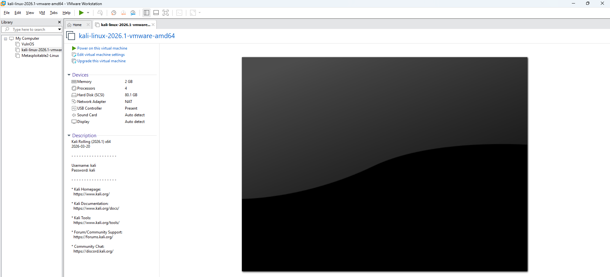
Kali Linux
Kali Linux is a Linux-based operating system designed for cybersecurity professionals, penetration testers, and ethical hackers.
It comes with hundreds of pre-installed security tools, such as:
Nmap – Network scanning
Wireshark – Network traffic analysis
Metasploit Framework – Penetration testing
John the Ripper – Password auditing
Burp Suite – Web application security testing

Slide 5
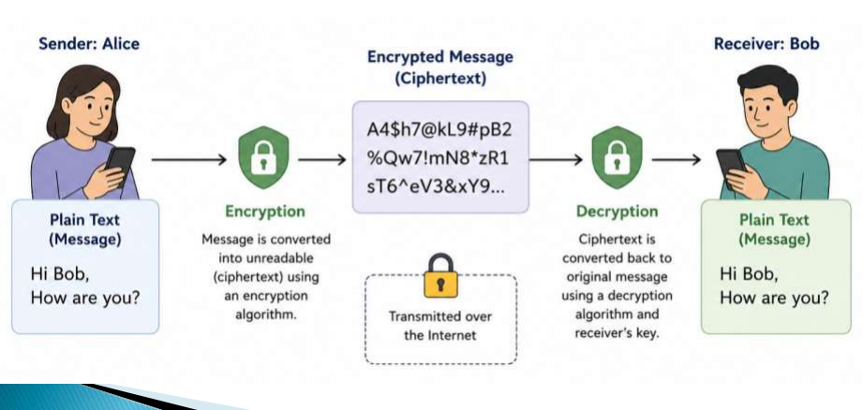
Cryptography:- Cryptography is the science of protecting information by converting readable data (plaintext) into an unreadable form (ciphertext) using mathematical algorithms and keys.

Slide 6
Week 1
Cryptanalysis of Caesar Cipher using frequency analysis.
Aim:-
To perform cryptanalysis of Caesar Cipher using frequency analysis technique and recover the original plaintext without knowing the secret key.

Slide 7
Introduction:- Cryptanalysis means analyzing encrypted data to break the encryption and find the original message without knowing the key. A Caesar Cipher is a substitution encryption technique where each letter in the plaintext is shifted by a fixed number of positions in the alphabet. Example: Plaintext: HELLO Key = 3 (shift right by 3) H → K E → H L → O L → O O → R Ciphertext: KHOOR Algorithm: 1. Read ciphertext. 2. Calculate frequency of each alphabet. 3. Find most frequent character. 4. Compare with English letter frequency. 5. Estimate Caesar shift key. 6. Apply reverse shift. 7. Display plaintext.

Slide 8
Example Ciphertext:- Step1:- Read ciphertext
GFS WMY OG LGDVS MF SFNKYHOSU ESLLMRS, PC WS BFGW POL DMFRQMRS,
PL OG CPFU MUPCCSKSFO HDMPFOSXO GC OIS LMES DMFRQMRS DGFR SFGQRI
OG CPDD GFS LISSO GK LG, MFU OISF WS NGQFO OIS GNNQKKSFNSL GC SMNI
DSOOSK. WS NMDD OIS EGLO CKSJQSFODY GNNQKKPFR DSOOSK OIS 'CPKLO',
OIS FSXO EGLO GNNQKKPFR DSOOSK OIS 'LSNGFU' OIS CGDDGWPFR EGLO
GNNQKKPFR DSOOSK OIS 'OIPKU', MFU LG GF, QFOPD WS MNNGQFO CGK MDD
OIS UPCCSKSFO DSOOSKL PF OIS HDMPFOSXO LMEHDS. OISF WS DGGB MO OIS
NPHISK OSXO WS WMFO OG LGDVS MFU WS MDLG NDMLLPCY POL LYEAGDL.
WS CPFU OIS EGLO GNNQKKPFR LYEAGD MFU NIMFRS PO OG OIS CGKE GC OIS
'CPKLO' DSOOSK GC OIS HDMPFOSXO LMEHDS, OIS FSXO EGLO NGEEGF
LYEAGD PL NIMFRSU OG OIS CGKE GC OIS 'LSNGFU' DSOOSK, MFU OIS
CGDDGWPFR EGLO NGEEGF LYEAGD PL NIMFRSU OG OIS CGKE GC OIS 'OIPKU'
DSOOSK, MFU LG GF, QFOPD WS MNNGQFO CGK MDD LYEAGDL GC OIS
NKYHOGRKME WS WMFO OG LGDVS.

Slide 9
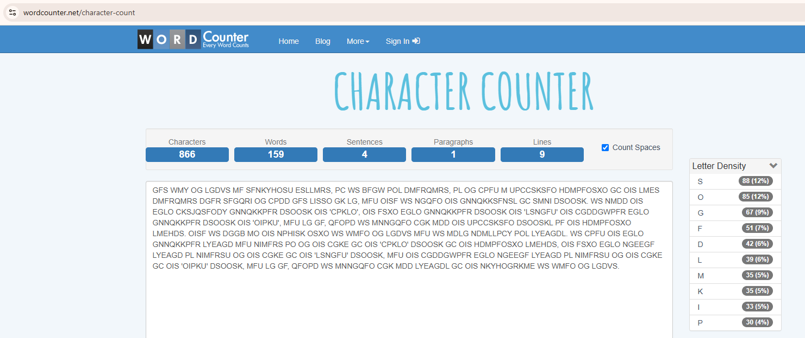
Step 2:-Calculate frequency of each alphabet.

Slide 10
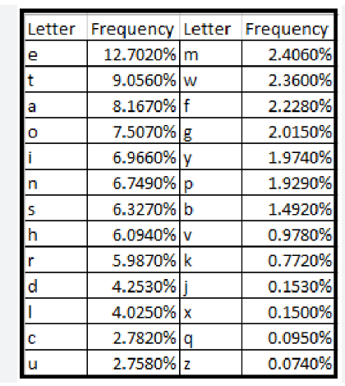
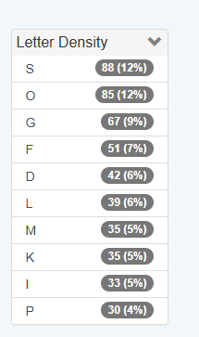
Step 3:- Find most frequent character. Step 4.:-Compare with English letter frequency.

Slide 11
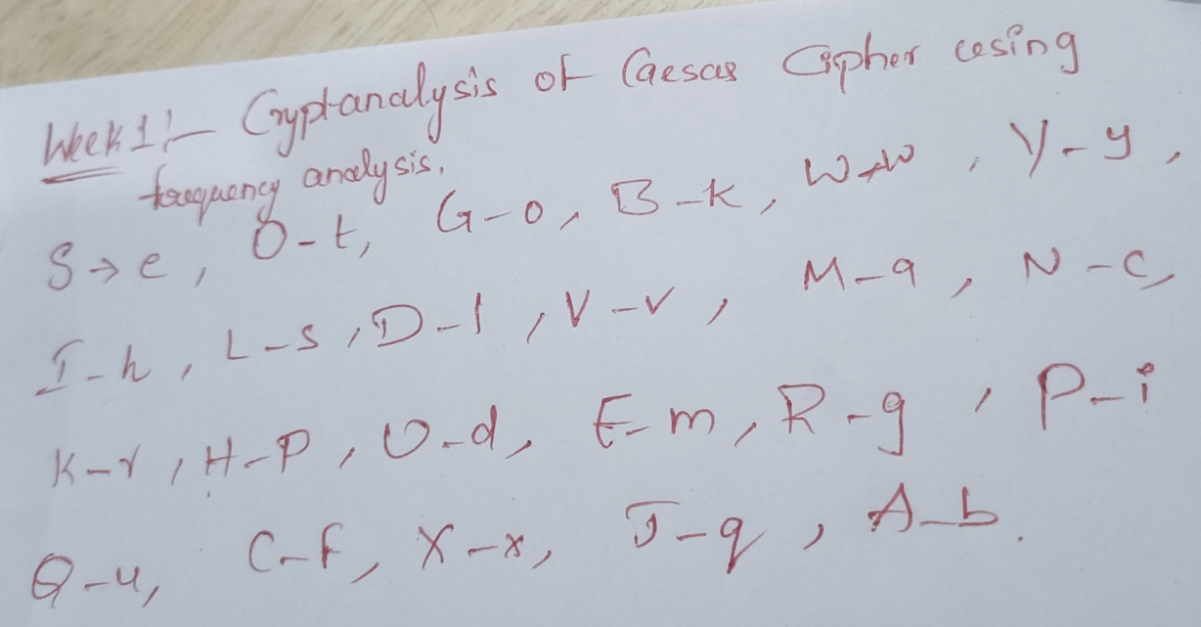
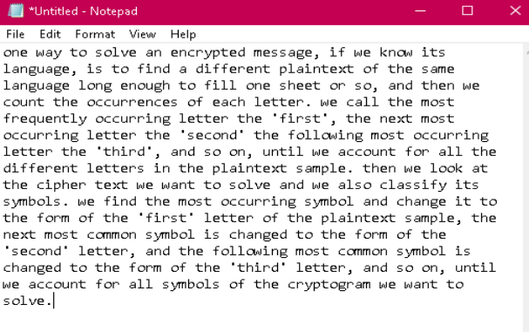
5.Estimate Caesar shift key. 6. Apply reverse shift. (Ctrl+F) 7. Display plaintext.

